Slide 1
Exomiser and related tools: improving prioritization of disease genes
Damian Smedley
Queen Mary University of London & Genomics England

Slide 2
Lecture summary
Phenotype ontologies
Phenotype matching algorithms
Application to next gen sequence analysis

Slide 3

Ontologies as computational tools
Ontologies are used for myriad applications in biomedical research and translational applications. The greatest common denominator is: Compute over human knowledge!
Functional profiling in high-throughput experiments
Network biology
Model, reason and manage complex data systems
Natural Language Processing (NLP)
et cetera

Slide 4
What is a phenotype ontology?
Precise language (and thinking), interoperability,
improved database models to reliably capture and interpret phenotype information.
A medical phenotype ontology describes the individual manifestations of diseases:
Signs
Symptoms
Laboratory findings
Imaging studies
Deep phenotype: The precise and comprehensive analysis of phenotypic abnormalities
Individual components of disease rather than ”gestalt”
Robinson RN (2012) Deep phenotyping for precision medicine. Hum Mutat 33: 777–780 (Special Issue of Human Mutation on Deep Phenotyping)

Slide 5
Human Phenotype Ontology
11,030 terms
117,348 annotations for ~ 7000 monogenic diseases
132,006 annotations for ~3145 common diseases
www.human-phenotype-ontology.org
Applications:
describing rare clinical disorders
prioritizing gene-disease targets
inferring novel drug interactions
linking human diseases to animal models
Interoperable with model organism data and basic research standards
A computable representation of human disease

Slide 6
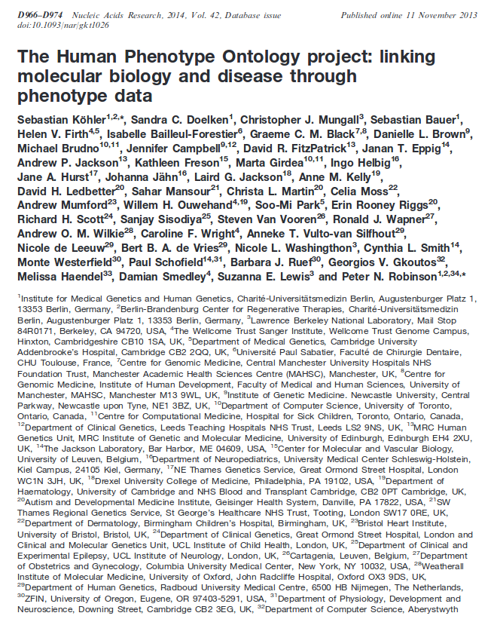

Widely used in the community
Databases & Bioinformatics Resources using HPO
DECIPHER (Sanger Institute)
DDD (Sanger Institute)
ECARUCA FORGE (Genome Canada)
GWAS Central
IRDiRC
ISCA
NCBI Genetic Testing Registry
NIH Undiagnosed diseases program
UK 100,000 Genomes Project
UMLS
Phenotips (Brudno Group, U Toronto)
Major credits go to OMIM and Orphanet

Slide 7
Lecture summary
Phenotype ontologies
Phenotype matching algorithms
Application to next gen sequence analysis

Slide 8
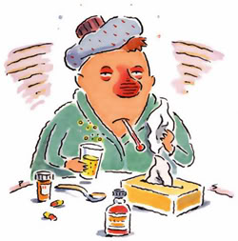
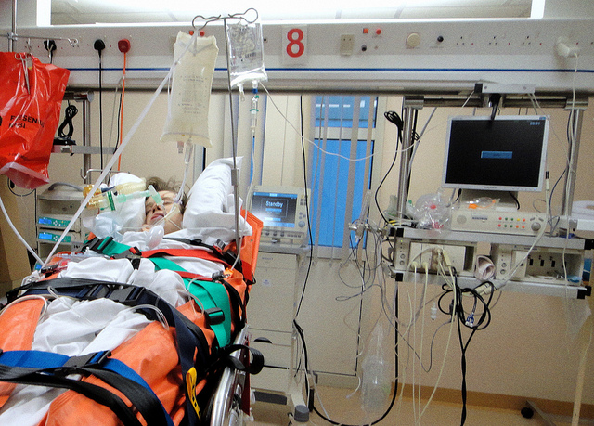
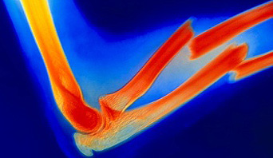
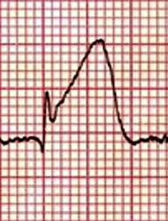
Similarity algorithms for medicine?
But how exactly do we calculate the similarity between diseases, symptoms, patients,. . .?

Slide 9
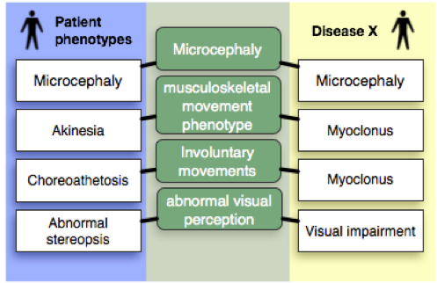
Phenotypic similarity algorithms
Basic idea of ontological search: Do not need exact match!
But semantically similar diseases score well

Slide 10
Information Content
Information content of common ancestor: similarity between ontology terms
Average similarity between terms can be used to compare two diseases

Slide 11
Ontological diagnostics

Slide 12
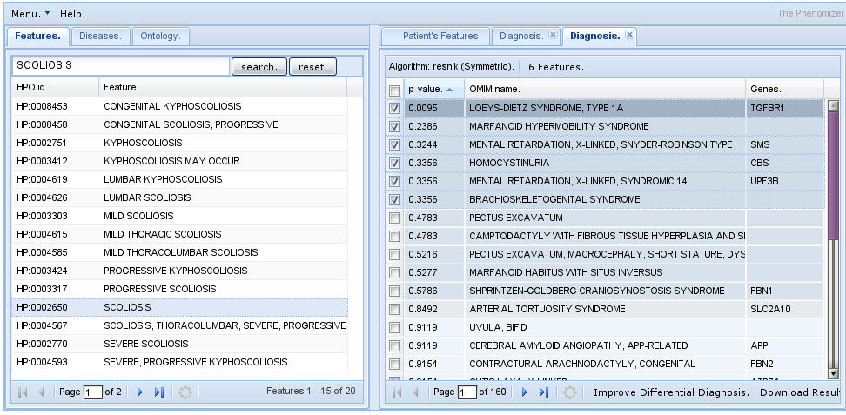
The Phenomizer
Sebastian Kohler et al. (2009) Clinical Diagnostics with Semantic Similarity Searches in Ontologies. Am J Hum Genet, 85:457–64.

Slide 13
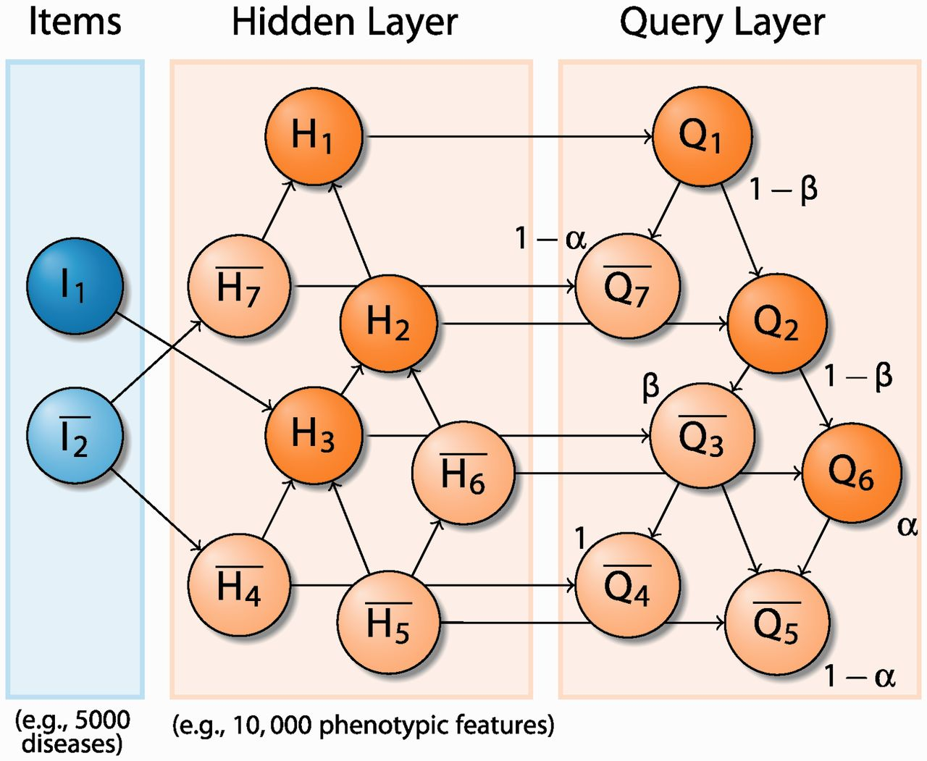
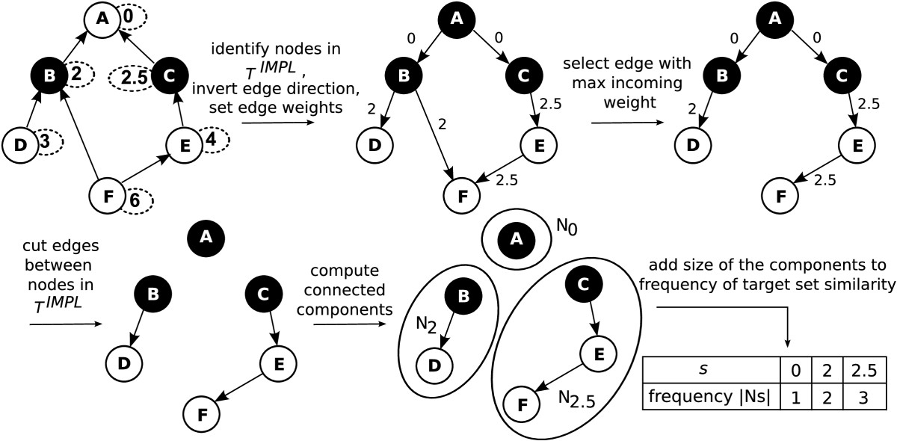
Phenotypic Similarity Algorithms
Goal: calculate a similarity between at set of query terms and computational disease models.
Phenomizer:
Kohler et al. (2009)
Am J Hum Genet 85:457-64
Exact Score Distribution:
Schulz MH et al (2011)
BMC Bioinformatics 12:441
BOQA:
Bauer et al. (2012) Bioinformatics 28:2502

Slide 14
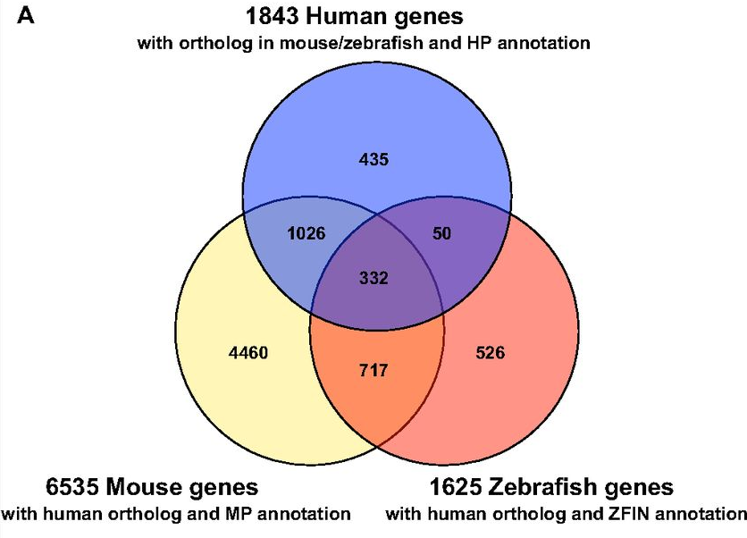
Model organisms: an underused resource for disease gene discovery
Doelken S C et al. Dis. Model. Mech. 2013;6:358-372

Slide 15
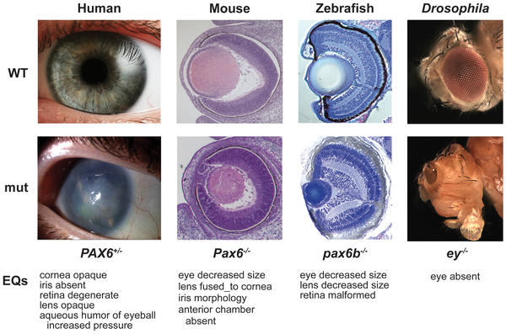
Animal models of human disease
Washington N et al. (2009). Linking Human Diseases to Animal Models Using Ontology-Based Phenotype Annotation. PLoS Biol, 7(11)

Slide 16
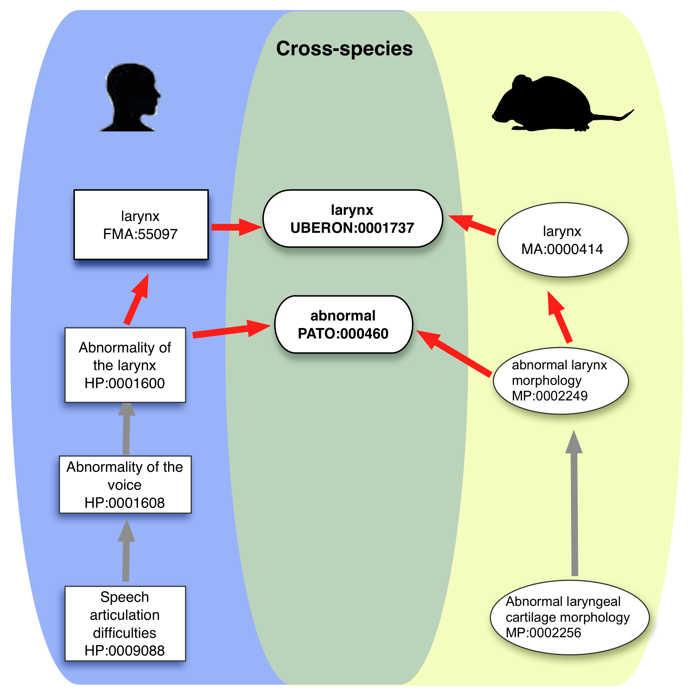
OWLSim: cross-species phenotype mapping

Slide 17
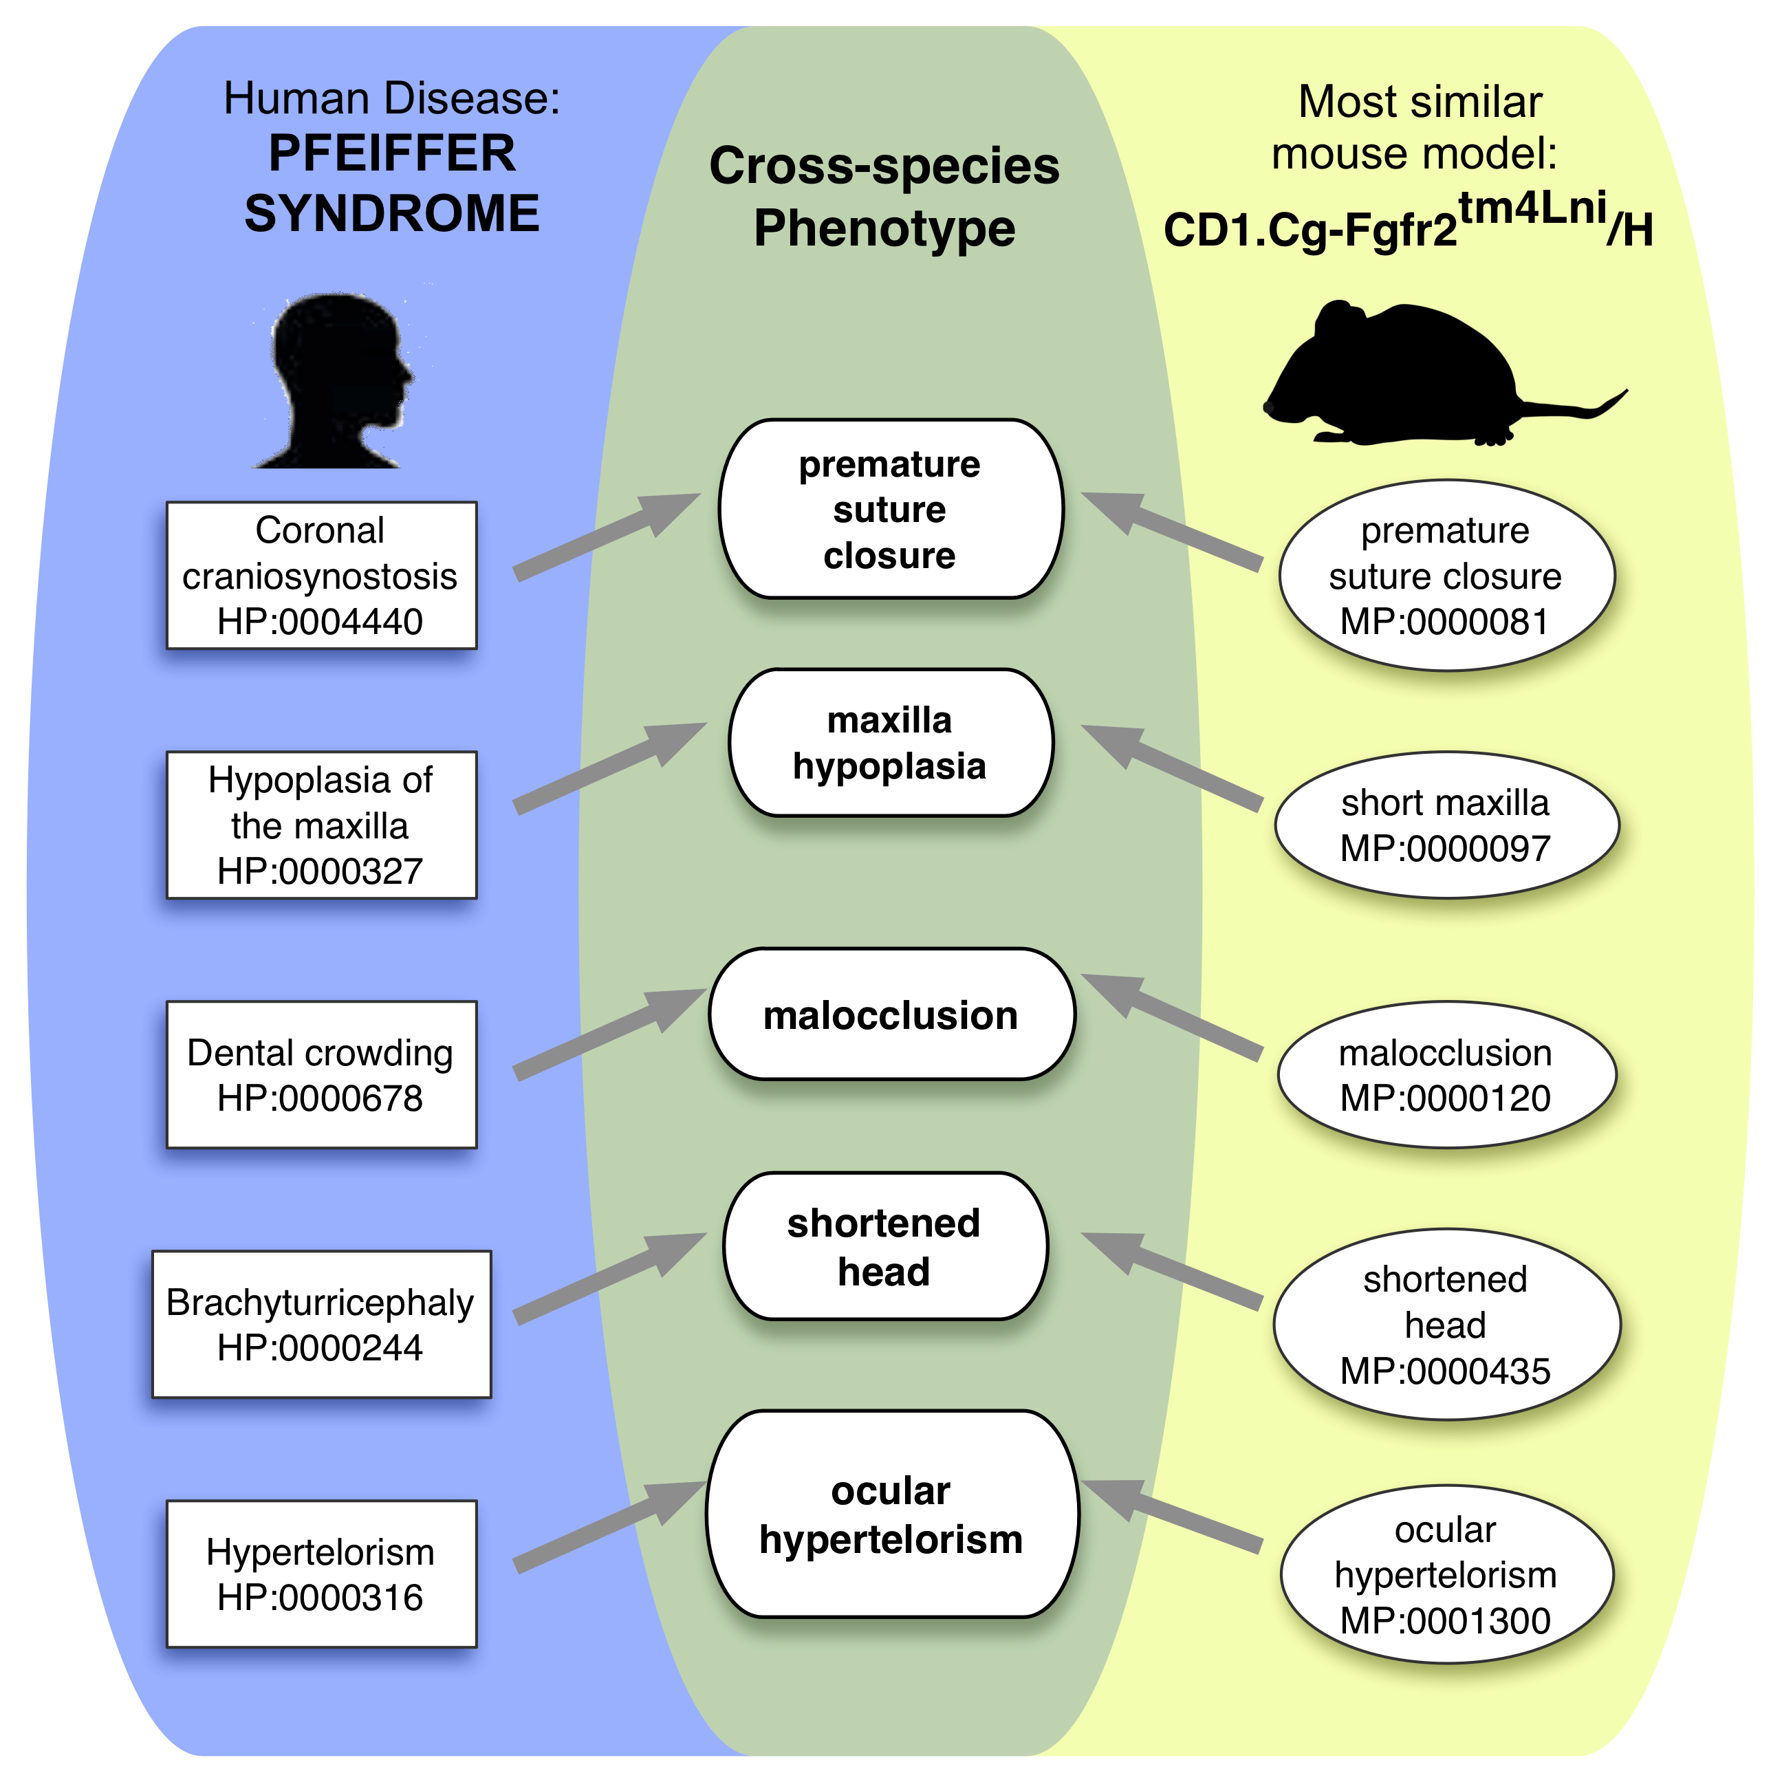
Cross-species phenotype comparisons by semantic similarity
Smedley D et al. Database. 2013; bat025
Mungall CJ et al. Genome Biol. 2010; 11(1):R2
Washington N et al. Plos Biol 2009; e1000247

Slide 18
Analysis of recall of known disease genes and mouse models

Slide 19
www.sanger.ac.uk/resources/databases/phenodigm

Slide 20

IMPC disease association pipeline
Diseases with phenotype annotations (HPO)
OMIM
Orphanet
DECIPHER
Mice with phenotype annotations (MP)
MGI
IMPC
Phenotype similarity comparisons
IMPC portal
Mouse models for known disease-gene associations
Candidates for novel disease-gene associations
Suggestions for secondary phenotyping projects

Slide 21
First Bernard-Soulier mouse model
mousephenotye.org

Slide 22
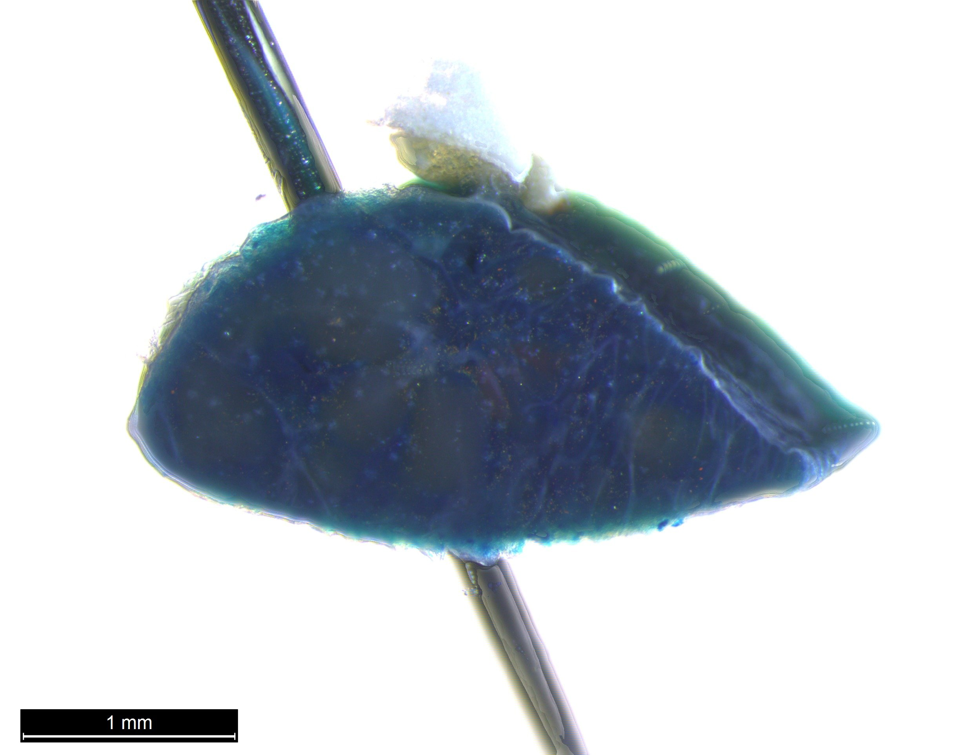
Spleen lacZ
Thrombocytopenia (MP:0003179)

Slide 23
Lecture summary
Phenotype ontologies
Phenotype matching algorithms
Application to next gen sequence analysis

Slide 24
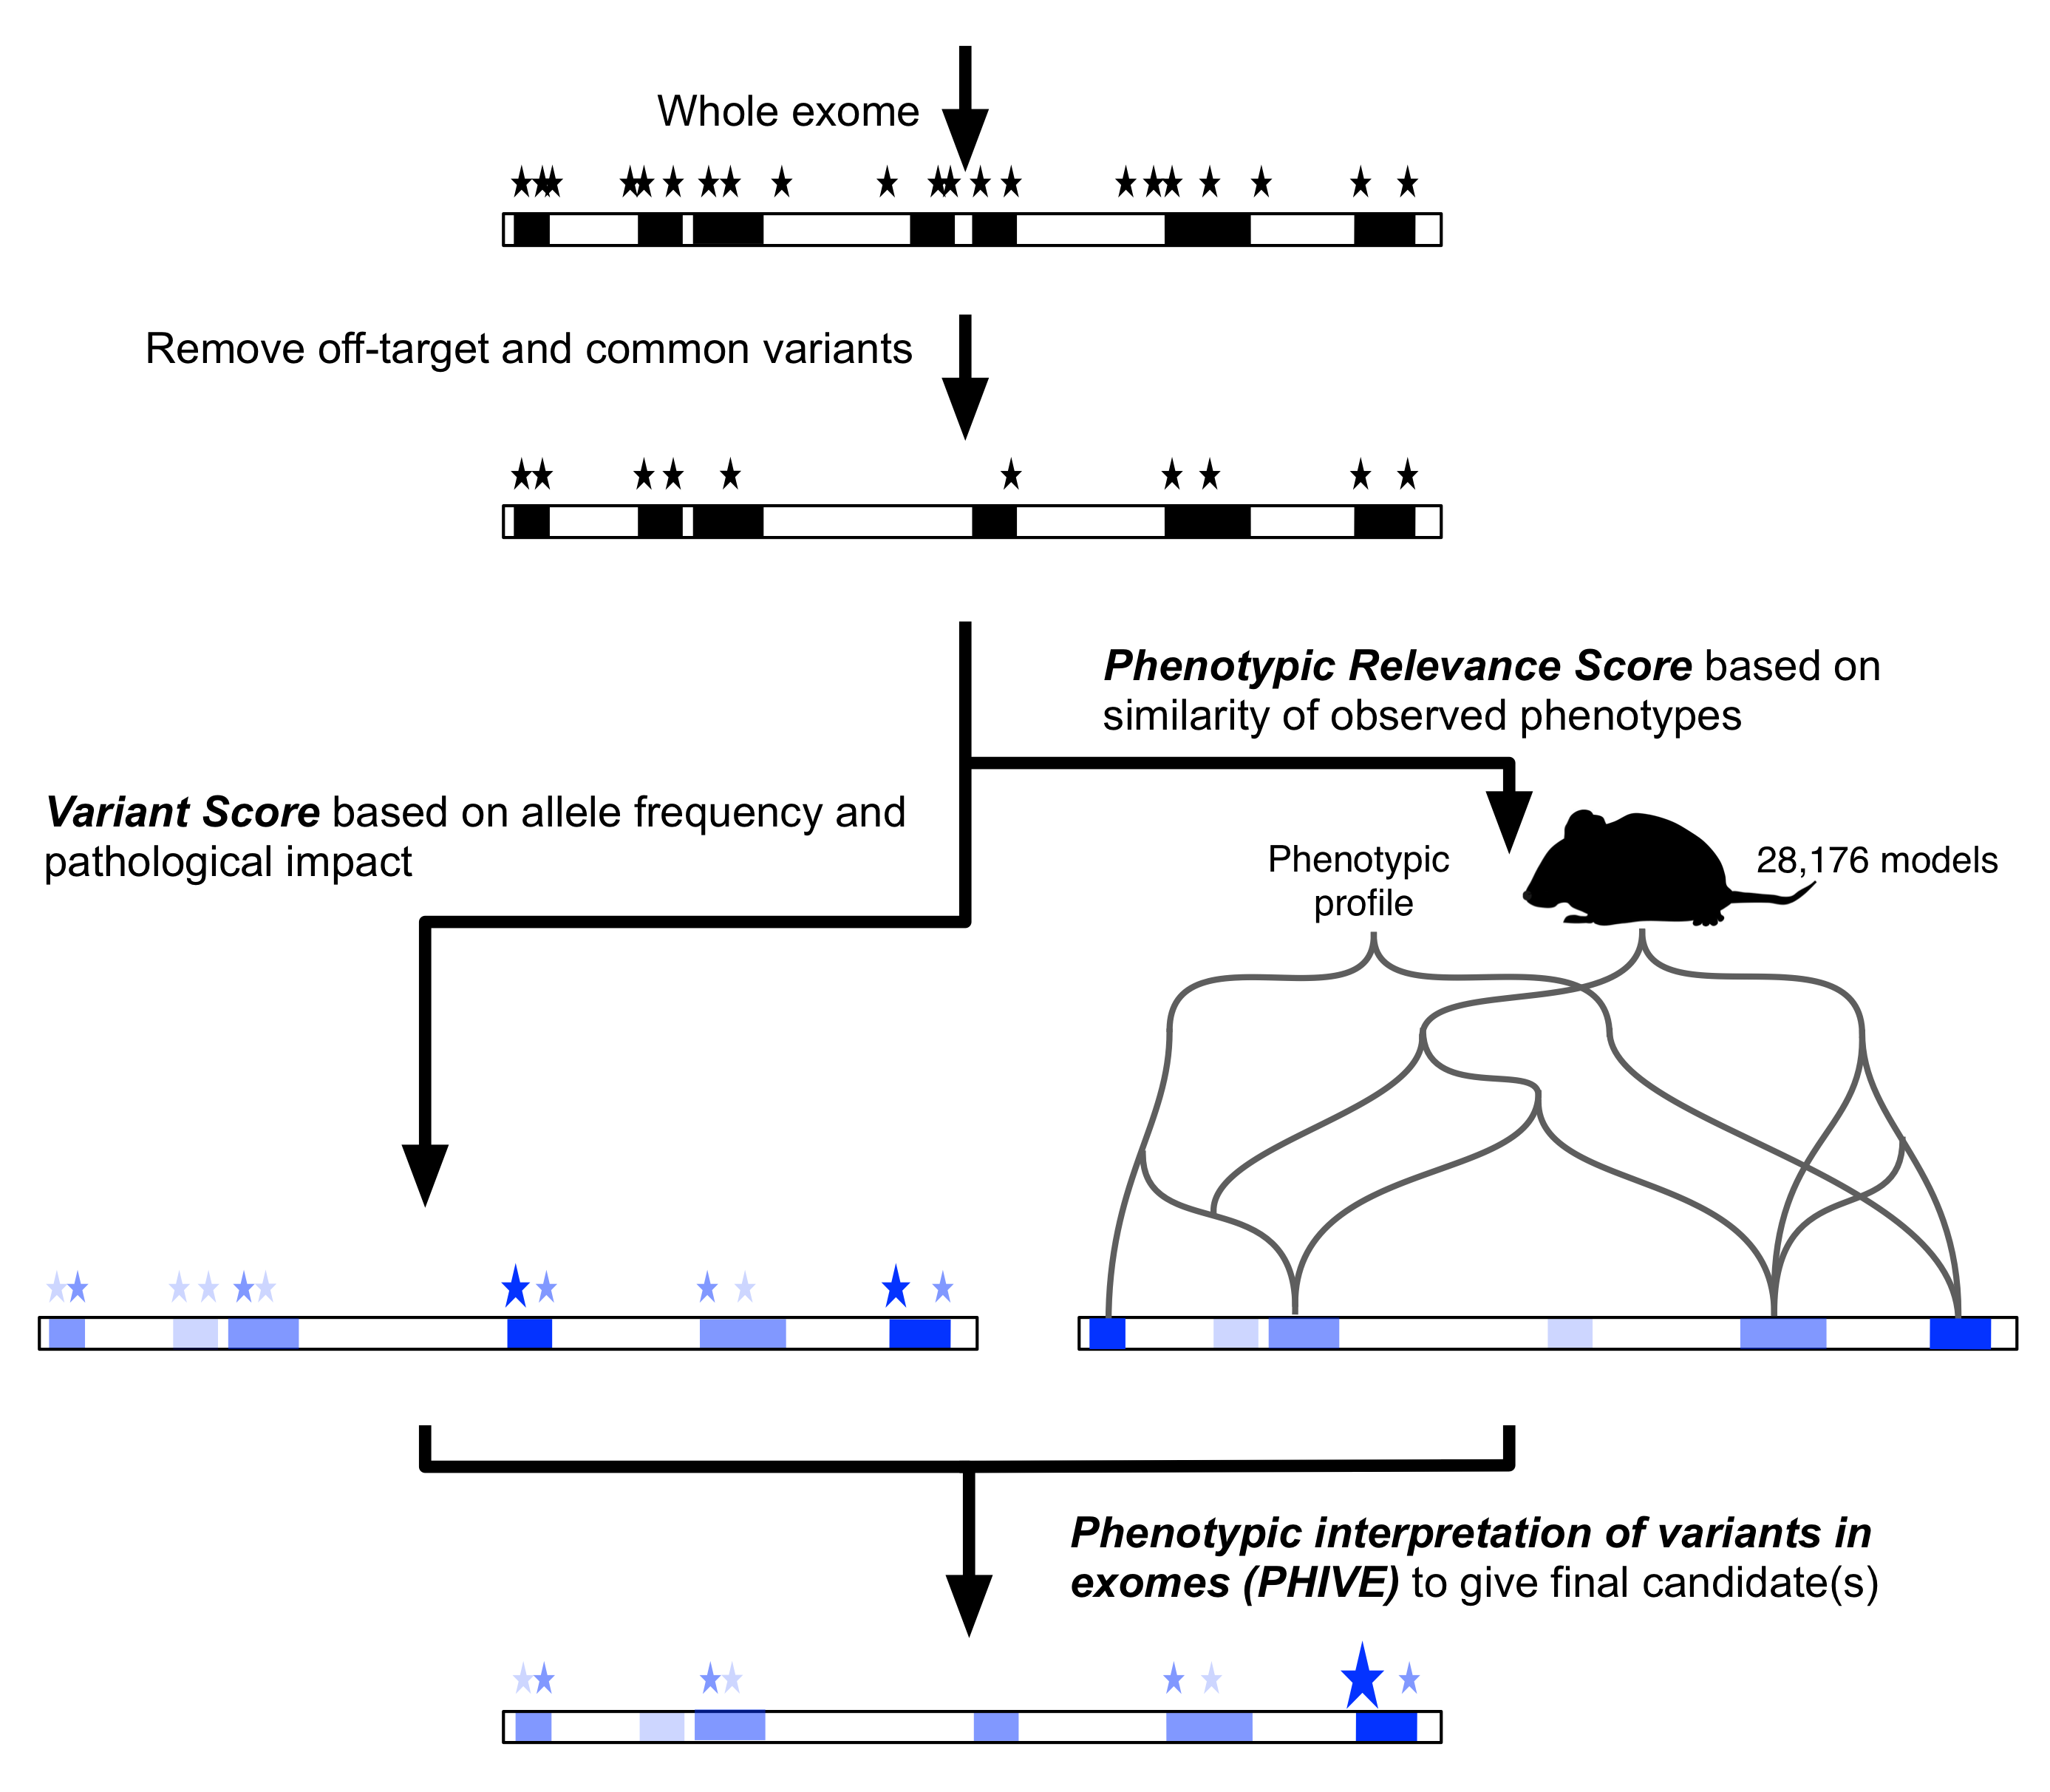
Standard exome analysis
Whole exome
Remove off-target and common variants
Prioritize based on allele frequency and pathogenicity
Linkage data
Multiple affected individuals
De novos from trios
Prior knowledge of affected pathways

Slide 25


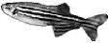
Exomiser
Whole exome
Remove off-target and
common variants
Variant score from allele
freq and pathogenicity
Phenotype score from
phenotypic similarity
PHIVE score to give final candidates

Slide 26
Benchmarking
100,000 simulated exomes
1092 unaffected exomes
28,516 disease associated variants
Annotate variants
Remove off-target, syn and common(>1%) variants (plus optional inheritance model filtering)
Prioritize based on combined score

Slide 27
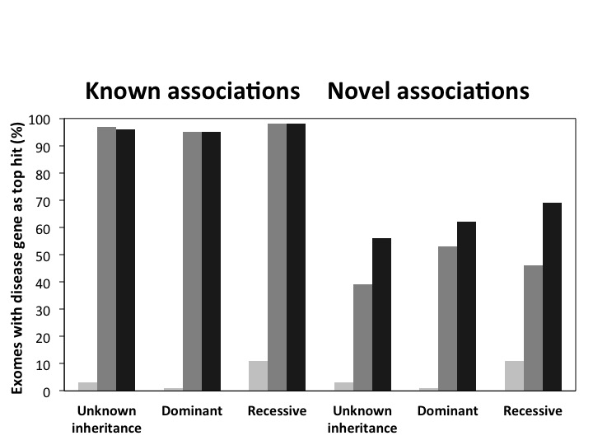
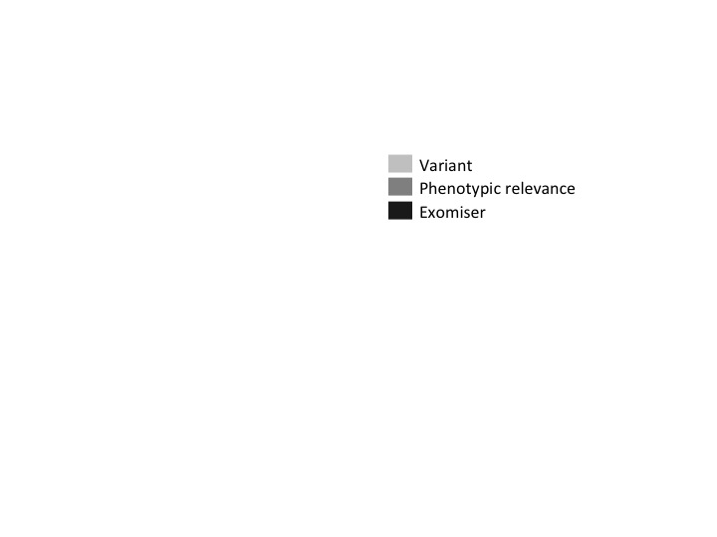
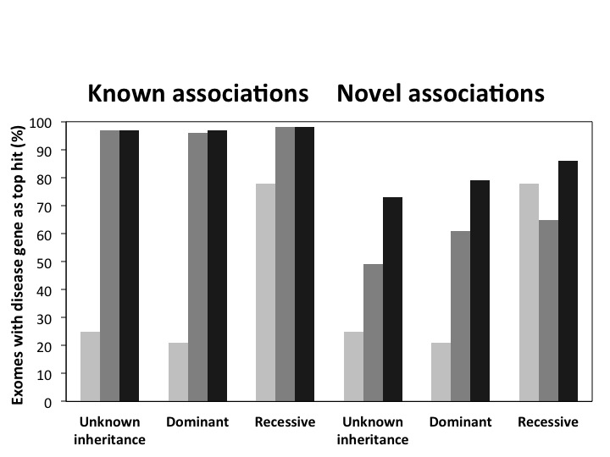
Variant and phenotype data synergistically identify causative variant

Slide 28
NIH Undiagnosed Disease Program
=> Use of genotype, phenotype and inheritance data together provide best prioritization

Slide 29
Integration into UDP pipeline
4/23 previously problematic cases received a diagnosis
One novel disease-gene discovery: York Platelet syndrome and STIM1
Strong candidates identified for other cases: functional validation through mouse and zebrafish modelling
Several hundred further cases now being analysed
Bone W et al. Genetics in Medicine 2015 (In Press)

Slide 30

UDP930/929 diagnosed with a SMS mutation

Slide 31


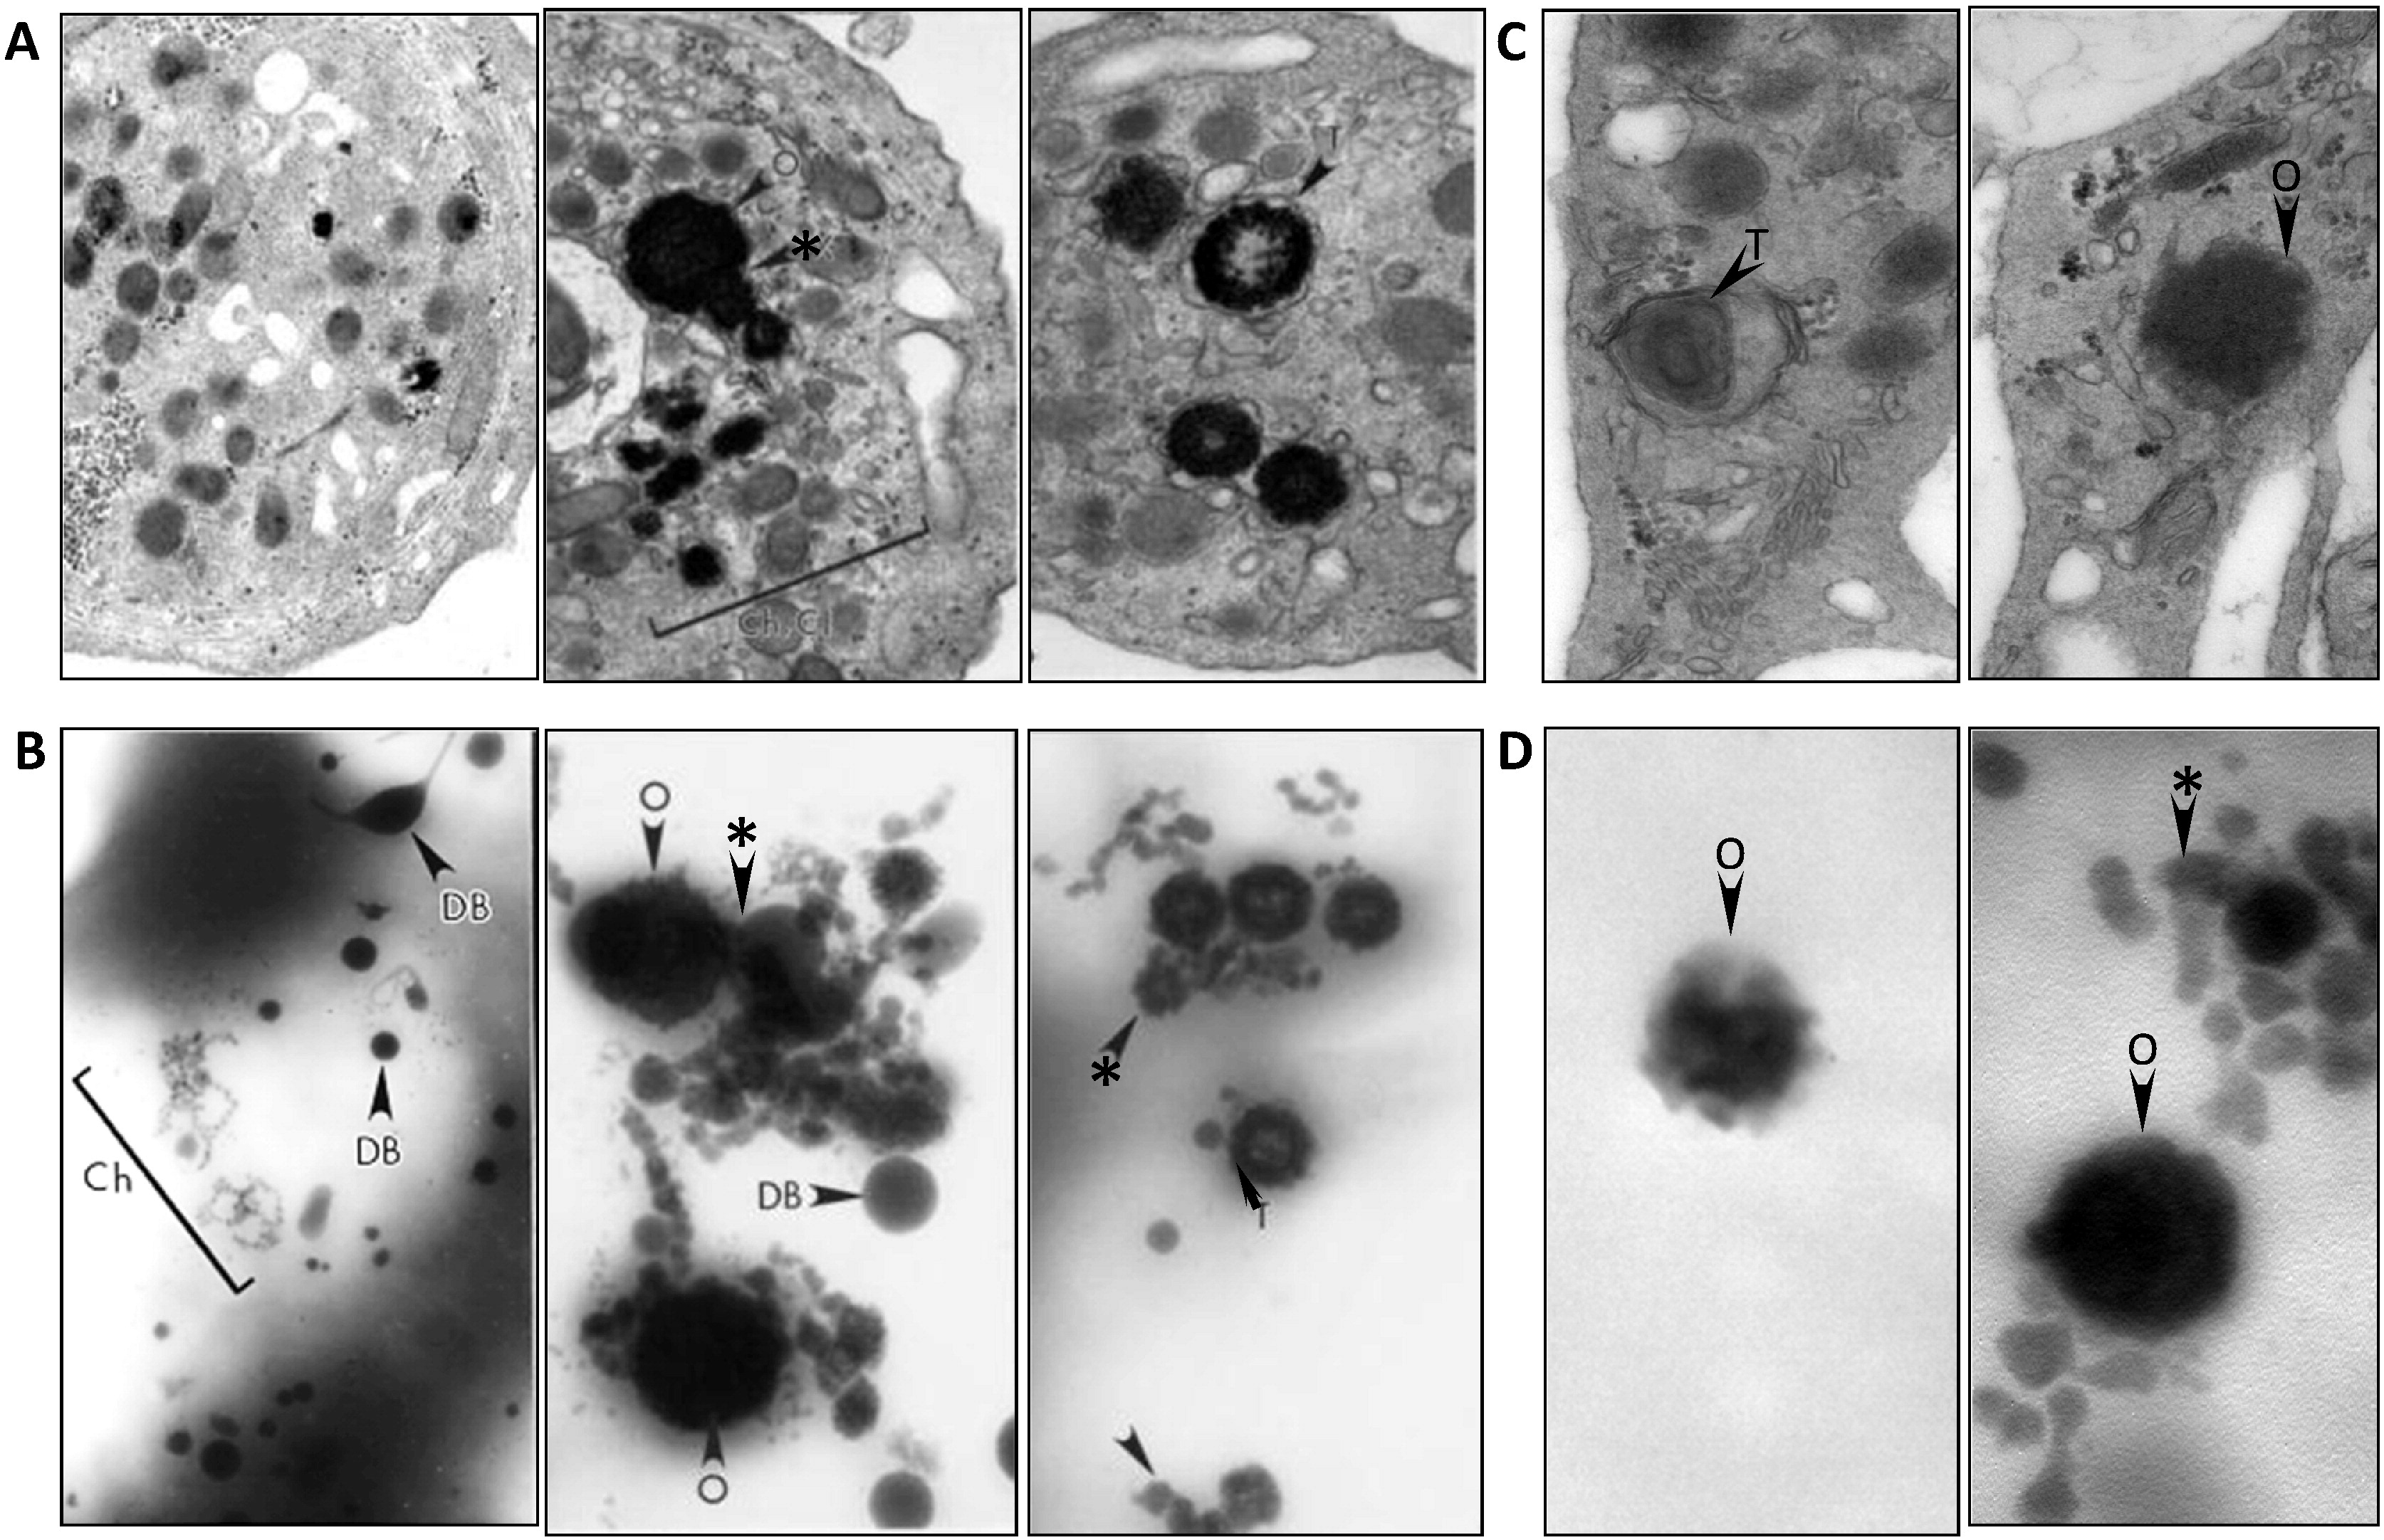
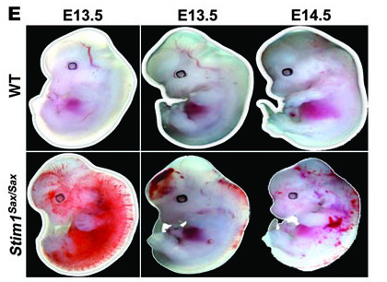
York platelet syndrome and STIM1
Markello T et al. Molecular Genetics and Metabolism 2015, 114: 474
Grosse J, J Clin Invest 2007 117: 3540-50
Impaired platelet aggregation
(HP:0003540)
Abnormal platelet activation
(MP:0006298)
Thromocytopenia (HP:0001873)
Thrombocytopenia (MP:0003179)

Slide 32
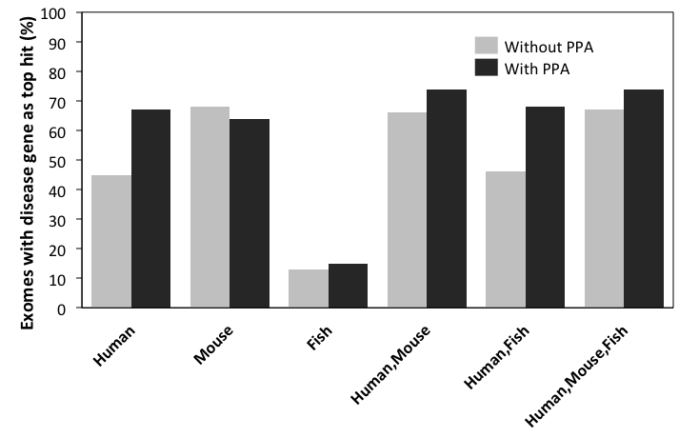
Contribution of species and PPA

Slide 33
But what about non-coding mutations?
Category | Literature curated variants
Enhancer | 38
Promoter | 128
5’UTR Transcription (core promoter) Upstream ORF Secondary structure Kozak sequence | 145 55 38 35 2
3’UTR Polyadenylation miRNA binding Secondary structure | 37 15 5 1
Large non-coding RNA gene | 59
MicroRNA gene | 4
Imprinting control region | 3

Slide 34
Properties of Mendelian regulatory mutations

Slide 35
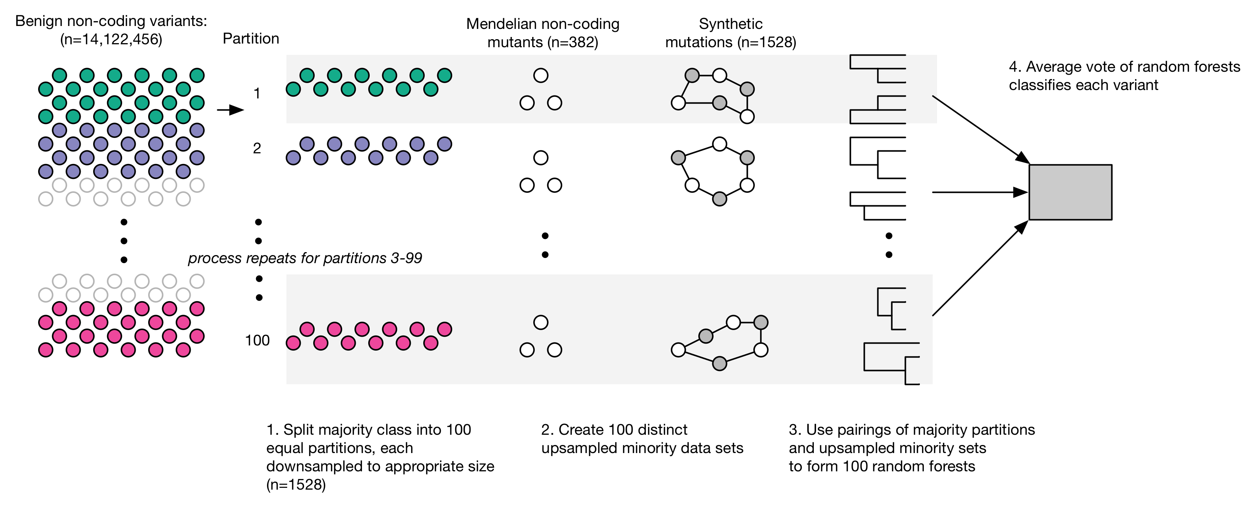
Training of REgulatory Mendelian Mutation (REMM) score

Slide 36
Performance of REMM score

Slide 37
Genomiser

Slide 38
Known Mendelian regulatory mutations

Slide 39
Exomiser software suite
How-To guide: Smedley D et al Nature Protocols 2015 10(12):2004-15
PHIVE: Robinson PN et al. Genome Research 2014. 24(2):340-8.
hiPHIVE: Bone W et al. Genetics in Medicine 2015 (In Press)
PhenIX: Zemojtel T et al. Science Translational Medicine 2014. 6(252).
ExomeWalker: Smedley D et al. Bioinformatics 2014 30(22):3215.

Slide 40
eXtasy
Sifrim A et al. Nature Methods 2013, 10:1083-1084

Slide 41
Phevor
Singleton MV et al. American Jol Human Genetics 2014, 4:599-610

Slide 42
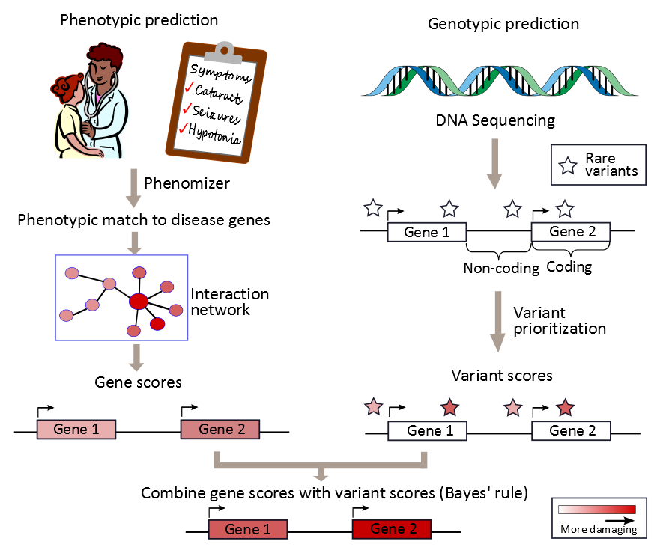
Phen-Gen
Javed A, Agrawal S & Ng PC. Nature Methods 2014, 11:935-7

Slide 43
Comparison to other phenotype-based variant analysis software
Smedley D & Robinson PN. Genome Medicine 2015, 7:81

Slide 44
Conclusions
Semantic phenotype comparisons greatly improve diagnosis and candidate gene identification as well as highlighting good disease models
Inclusion of mouse and fish phenotypes along with guilt by association from PPA data is critical, especially for novel disease gene discovery
There is clear value in collecting deep clinical phenotype data for translational bioinformatics

Slide 45
Acknowledgments
NIH-UDP
William Bone
Murat Sincan
David Adams
Amanda Links
Joie Davis
Neal Boerkoel
Cyndi Tifft
Bill Gahl
OHSU
Melissa Haendel
Nicole Vasilesky
Matt Brush
Bryan Laraway
Shahim Essaid
Kent Shefchek
EBI
Terry Meehan
Helen Parkinson
Jeremy Mason
Chao-Kung Chen
Sanger
Bill Skarnes
Anika Oelllrich
Jules Jacobson
Irene Papatheodorou
Toronto
Marta Girdea
Sergiu Dumitriu
Heather Trang
Orion Buske
Mike Brudno
JAX
Cynthia Smith
Charité
Sebastian Kohler
Sandra Doelken
Max Schubach
Peter Robinson
Lawrence Berkeley
Nicole Washington
Suzanna Lewis
Chris Mungall
MRC Harwell
Ann-Marie Mallon
Hugh Morgan
Ahmad Retha
Andrew Blake
Armida Di Fenza
Duncan Sneddon
Gagarine Yaikhom
Henrik Westerberg
Luis Santos
Tanja Fiegel
NIH: U54 HG006370-01
NIH Office of Director: 1R24OD011883
NIH-UDP: HHSN268201300036C, HHSN268201400093P

